Slide 1

Anomaly detection
NGO NGUYEN THANH THANG - 20229549

Slide 2
Data set description

Slide 3
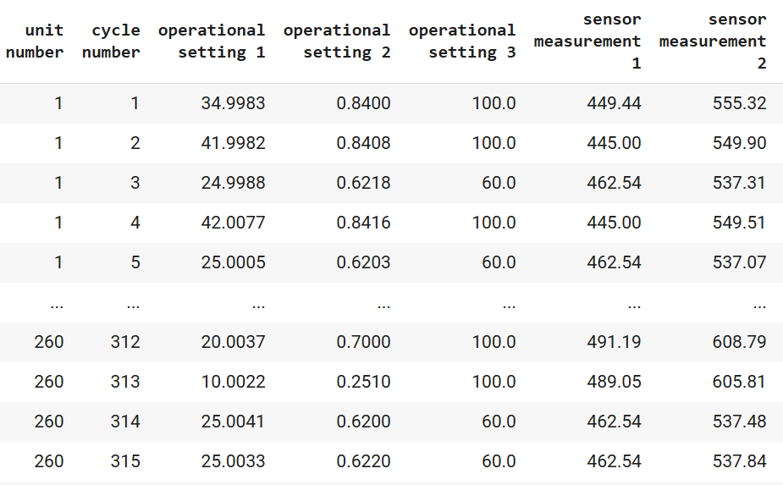
The data consists of multiple multivariate time series, each representing a different engine.
All engines are of the same type, each with unknown initial wear and manufacturing variations considered normal
Engines operate under three operational settings affecting performance
Data is contaminated with sensor noise
Data set has 26 features

Slide 4
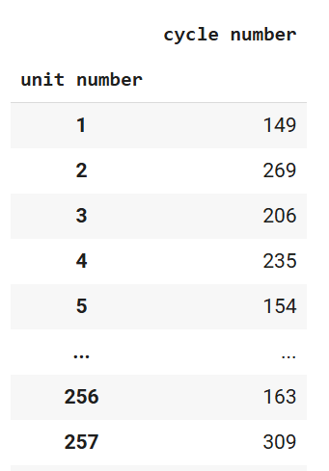
Each time series begins with normal operation and develops a fault that leads to system failure in the training set.
The data is already divided into training and test subsets.
In the test set, the series ends before system failure.

Slide 5
Objectives
Detect Anomaly
Predict the Remaining Useful Lifecycle (RUL) for engines in the test set

Slide 6
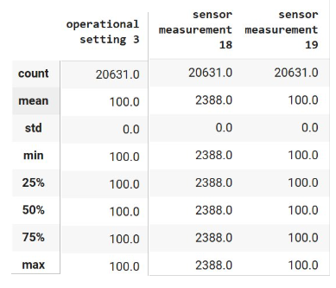
Basic EDA
Lacking information regarding the variables (features)
Cannot extract any impactful insight

Slide 7
Model Building
Objective 1: Detect any anomaly or unusual occurrence in the time series
Model Name: Hugging Face's Zero-shot classification

Slide 8
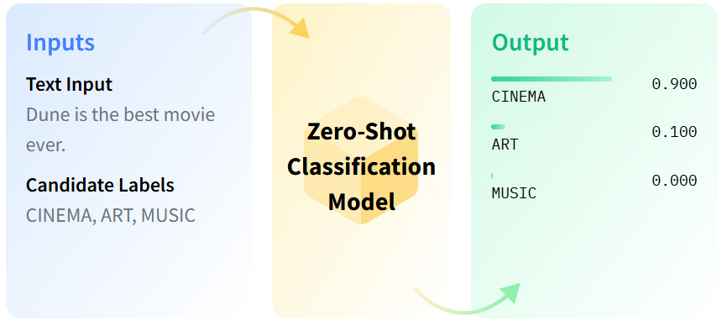
How to use hugging face's Zero-shot classification model

Slide 9
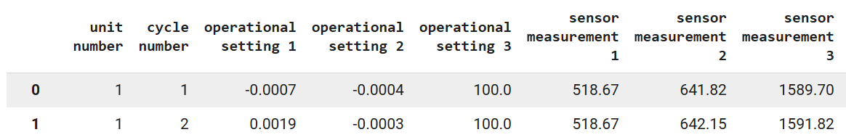
How to use Zero shot for anomaly detection
Text format: unit number:1.0 at cycle number:1.0, operational setting 1:-0.0007, …. sensor measurement 26: 0.02

Slide 10
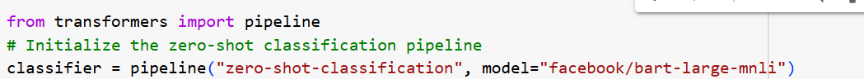
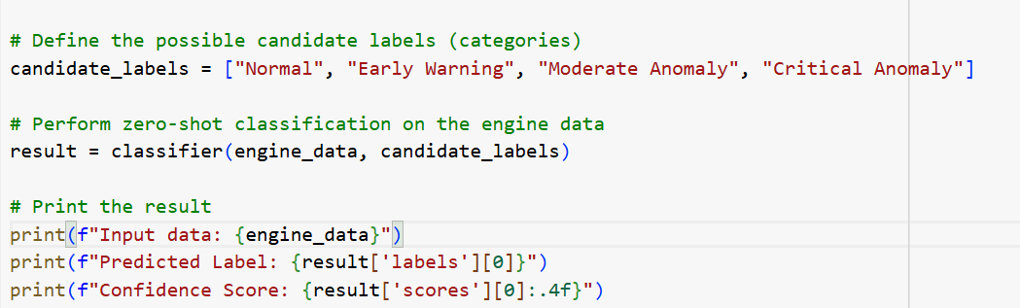

Slide 11
Objective 2: Predict the Remaining Useful Lifecycle (RUL) for engines in the test Set
Autoencoders
Linear Regression

Slide 12
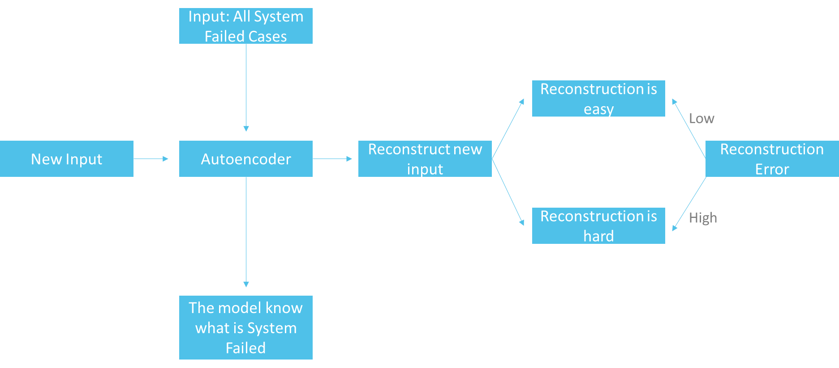
Autoencoder

Slide 13
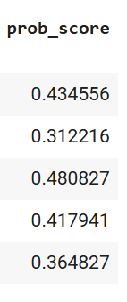
Scale Reconstruction error to probability format
Prob_score: the probability that the system would fail and shut down

Slide 14
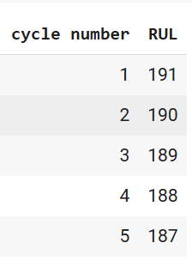
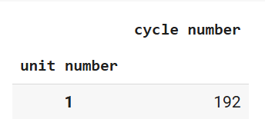
Calculate the Remaining Useful Lifecycle (Rul) for the train set
RUL = The Cycle in which the system failed – the current cycle

Slide 15
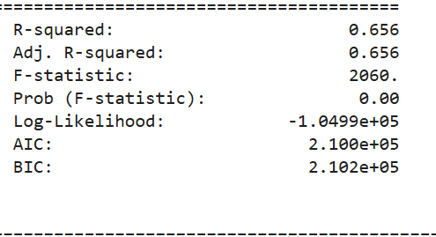
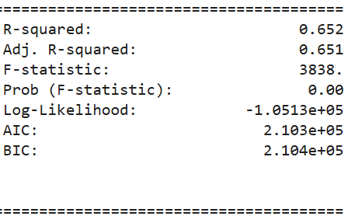
Build multivariate linear regression to predict RUL (Remaining useful lifecycle)
Regress all variables (features) against RUL
Reduced 26 features to 10 features using PCA then perform regression

Slide 16
build multivariate linear regression to predict RUL (Remaining useful lifecycle)
Choose Regress all variables (features) against RUL
Lacking information regarding variables (features)
Increase the accuracy
Accept the risk of over-fitting

Slide 17
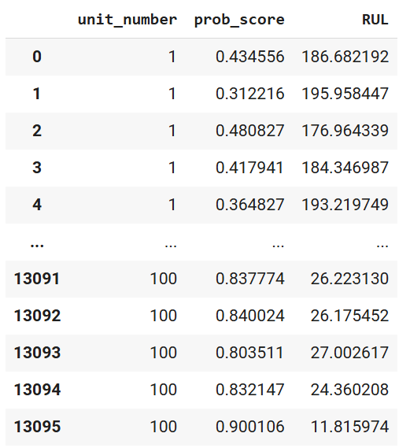
Fit test data to the multivariate linear regression model

Slide 18
How to predict the RUL
Predict RUL using only the last recorded cycle of each unit
Predict using the smallest RUL found for each unit number
If unit 1 has 200 recorded cycle, then we will use the RUL computed from the 200th cycle as our final prediction.
If unit 1 has 200 recorded cycle, then we will use the smallest RUL computed from the 200 cycles as our final prediction (choose the smallest RUL among the 200 computed RULs)

Slide 19
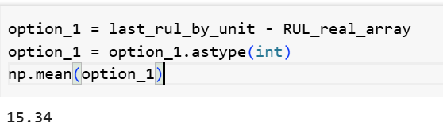
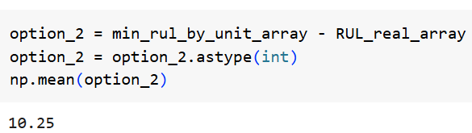
How to predict the RUL
Predict RUL using only the last recorded cycle of each unit
Predict using the smallest RUL found for each unit number
Average of:
(Predicted RULs – Real RULs)
Produces higher margin of error
Average of:
(Predicted RULs – Real RULs)
Produces lower margin of error

Slide 20
How to predict the RUL
Predict RUL using only the last recorded cycle of each unit
Predict using the smallest RUL found for each unit number
Advantage:
More Cost-effective, as the RULs become longer you don't have to check the system too often.
Drawback:
Suffer higher risk that the system would fail
Advantage:
The risk that the system would fail is lower
Drawback:
Higher maintenance cost

Slide 21
Conclusion & Limitation
The model’s fit is not high (R^2 = 0.65)
=> Have to build other models or compute other appropriate variables.

Slide 22
References
Google DeepMind. (n.d.). Gemini. DeepMind. https://www.deepmind.com
Hugging Face. (n.d.). Hugging Face. https://huggingface.com
OpenAI. (n.d.). ChatGPT. OpenAI. https://www.openai.com

